Slide 1
Politics
The environment of Texas Politics

Slide 2
Introduction
Texas is a majority republican state that has unique politics as compared to any other state in the US.
There is an increased differences in party positions and differences within the Texas parties that have continued to exist for many years.
Texas is one of the diverse states with populations of free slaves and majority immigrants.
Thesis: The history of Texas as a republican state has shaped its political culture, the governance, the policies and political characteristics of the state.
Notes:
Texas is a majority republican state that has unique politics as compared to any other state in the US.
There is an increased differences in party positions and differences within the Texas parties that have continued to exist for many years.
Texas is one of the diverse states with populations of free slaves and majority immigrants.
Thesis: The history of Texas as a republican state has shaped its political culture, the governance, the policies and political characteristics of the state.

Slide 3
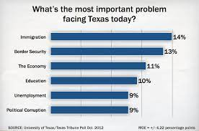
Biggest Political issue in Texas
Notes:
It is clear that immigration politics and debates seem to be the main political issue that faces Texas today. The other issues that seem to have been divisive and addressed by Trump are also significant challenges faced by Texas

Slide 4
Immigration Politics
One of the most contentious issues in the Texas politics is the immigration laws.
In May of 2017, the governor of Texas passed a legislation in which he passed city policies and laws that would assist the federal government in the immigration efforts.
The Sanctuary cities often refer to the municipal jurisdictions in North America that have limited the cooperation with national governments effort to have enforcement of immigration law.
Notes:
The Texas legislature passed a law punishing sanctuary cities while California became a sanctuary state. According to the Republican controlled Texas senate, the final stamp was given on a controversial bill in which state and local entities have been prevented from enforcing immigration laws. The Texas Senate Bill 4, filed a law in which state and local entities have refused to have cooperation with federal immigration officials and or even enforcement of immigration laws. In this sanctuary bill, it was evident that the local government would punish the local agencies that have failed to honor requests such as detainers from the customer’s enforcement and federal immigration laws.

Slide 5
Texas and the Federal Government
Texas has a luke-warm relationship especially to individuals working for the federal government.
The Texas law is punitive to anyone who works with federal government on immigration status within its jurisdiction
e business friendly systems, the low cost systems, the low taxes, the conservatives agenda have always been engaging experiment to prevent the federal system from having control on the local politics.
Notes:
Texas has a luke-warm relationship especially to individuals working for the federal government.
The Texas law is punitive to anyone who works with federal government on immigration status within its jurisdiction
e business friendly systems, the low cost systems, the low taxes, the conservatives agenda have always been engaging experiment to prevent the federal system from having control on the local politics.

Slide 6
Changing Demographics
Everything about Texas seems to have changed.
Texas population of youngsters who have come from nothing and made it in life has increased.
Texas has become the second largest state due to its growth of populations.
The republican controlled state has moved to the control of many democrats leading to a change of laws over the years.
Notes:
Everything about Texas seems to have changed.
Texas population of youngsters who have come from nothing and made it in life has increased.
Texas has become the second largest state due to its growth of populations.
The republican controlled state has moved to the control of many democrats leading to a change of laws over the years.

Slide 7
Republican Dominance
Texas politics is dominated by Republican ideologies
The senate and lower houses are controlled by majority republicans
Trump and Cruz have both won to become popular in Texas as they are majority of population
While Republicans win in some of these states, Texas is a highly republican state.
Notes:
Texas politics is dominated by Republican ideologies
The senate and lower houses are controlled by majority republicans
Trump and Cruz have both won to become popular in Texas as they are majority of population
While Republicans win in some of these states, Texas is a highly republican state.

Slide 8
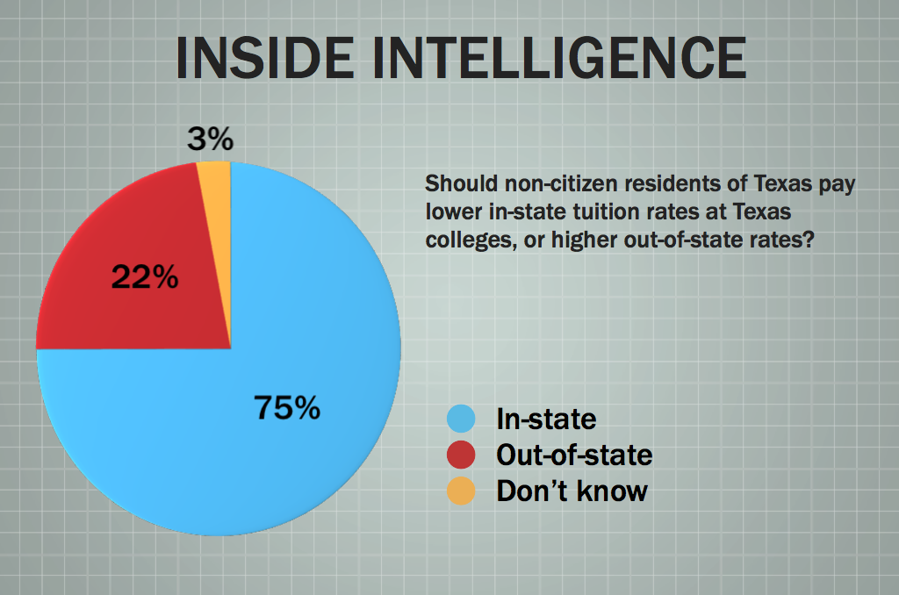
Political characteristics
Notes:
Most of the political characteristics with majority of immigrants in the state who have been unregistered seem to call for the need of the state of Texas to have lower tuition fees, tough immigration laws and also higher wages to reduce poverty rates. it is clear that Texas Republicans have always maintained a conservative agenda whose focus is to ensure that the government provides regulations for the locals on illegal immigration. Policies have been established by both states to ensure that progressive agenda on the issue of immigration has been upheld.

Slide 9
Political issues in Texas
The social history of Texas seems to have shaped and defined its politics
Any politician who wants to win should come up with a conservatism agenda especially in matters economy growth
Immigration, public education and police reforms seems to be the main contentious issues that face the population over the years.
Notes:
The social history of Texas seems to have shaped and defined its politics
Any politician who wants to win should come up with a conservatism agenda especially in matters economy growth
Immigration, public education and police reforms seems to be the main contentious issues that face the population over the years. The population wants to have a diversity in the opinions of the people especially through significant issues that affect the population.

Slide 10
Civil Liberties Policy
Affirmative action in Texas is aimed at improving civil liberties among populations
In Texas there has been issues related to race admissions in the Universities.
The state is faced with significant issues that affect population in terms of policing agenda
Texas needs reformation on employment laws and policies which are a major challenge.
Notes:
Affirmative action in Texas is aimed at improving civil liberties among populations
In Texas there has been issues related to race admissions in the Universities.
The state is faced with significant issues that affect population in terms of policing agenda
Texas needs reformation on employment laws and policies which are a major challenge.

Slide 11
Recommendations
There are majority of conservative politicians in Texas
The baseline of party identity in Texas is Republican.
The diverse population in Texas wants the contentious issues of immigration to be addressed by politicians
Any politician who wants to win in Texas has to have more conservatives ideology.

Slide 12
Conclusion
To sum it up, Texas is a state dominated by republicans.
Most of the people who plan to win Texas have to adopt the divisive politics that seem to have won the state for many years
Conservative candidates seem to be more favored to win the politics of Texas for many years.
Republicans who run on the contentious issues stand more chance to win that democrats.
Notes:
To sum it up, Texas is a state dominated by republicans.
Most of the people who plan to win Texas have to adopt the divisive politics that seem to have won the state for many years
Conservative candidates seem to be more favored to win the politics of Texas for many years.
Republicans who run on the contentious issues stand more chance to win that democrats.

Slide 13
References
Brown, Lyle C., et al. (2017-2018). Practicing Texas Politics. 17th Ed. Cengage Learning
Krane, D., Hill, M. B. and Rigos, P. N. Home rule in America: A fifty-state handbook. Washington, DC: CQ Press. 2011. Print.
Horwitz, J. and Anderson, C. Guns, democracy, and the insurrectionist idea. Ann Arbor: University of Michigan Press. Print.

